Slide 1
TREAP
25125039 - Nguyễn Lê Trân
25125065 - Bùi Viết Thành
25125071 - Lê Quỳnh Anh
25125078 - Đinh Nguyễn Hồng Ánh

Slide 2
Definition and History

Slide 3
TREAP = TREE + HEAP

Slide 4
Definition
A treap is a randomized binary search tree in which each node stores two values in the set of (X, Y):
(1) a key (X value), used to maintain the binary-search-tree (BST) ordering
(2) a priority (Y value), chosen randomly at insertion time and used to maintain a heap ordering.

Slide 5
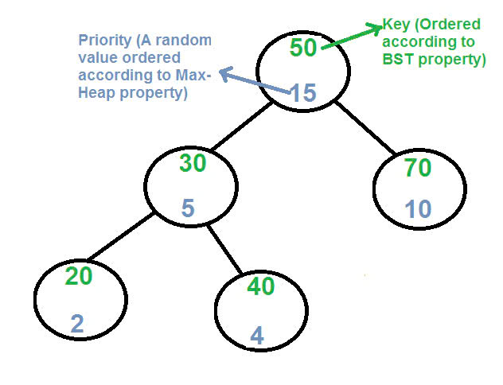
Definition

Slide 6
Historical notes
Treaps were introduced by Seidel and Aragon (1989) under the name randomized search trees.

Slide 7
Balanced Search Tree (AVL, Red-Black) vs. Treap
in their performances to achieve balance?

Slide 8
Balanced Search Tree | Treap
Achieve balance by maintaining strict structural constraints (balance factor and coloring rules) | Achieve balance in expectation through randomization

Slide 9
Core Data Structure

Slide 10
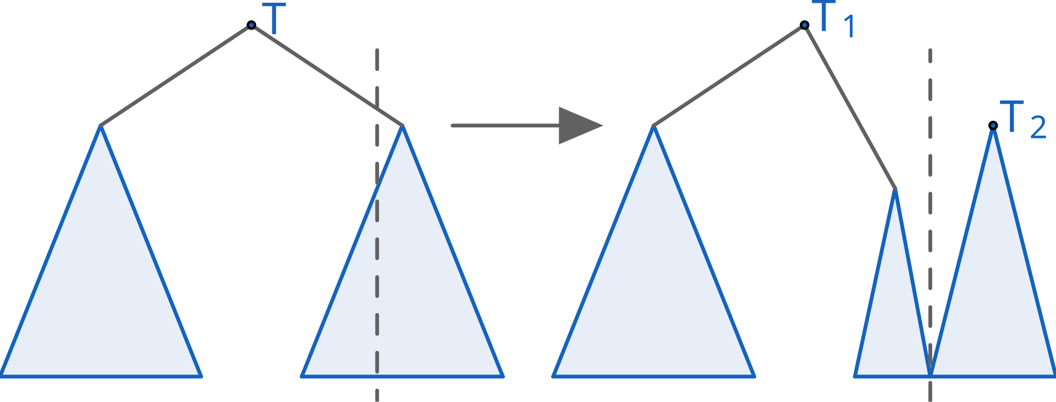
Split

Slide 11
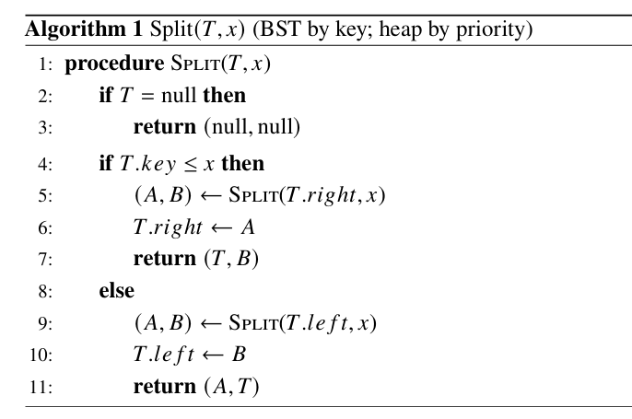
Split – pseudocode

Slide 12
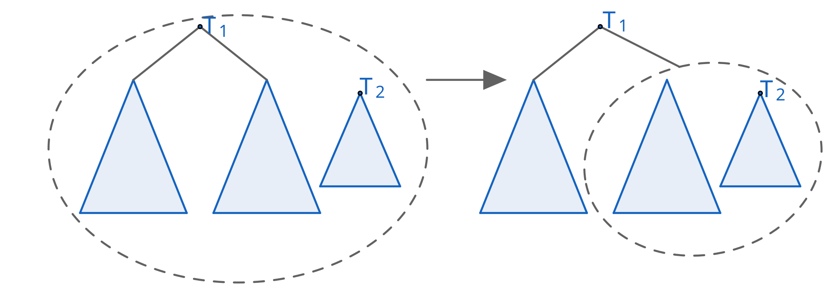
Merge

Slide 13
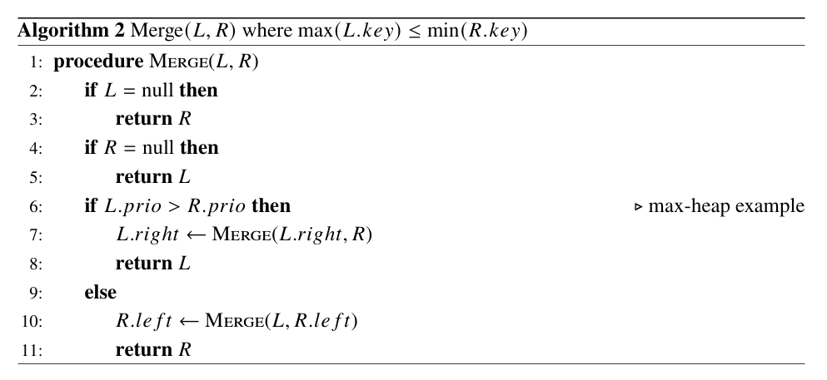
Merge – pseudocode

Slide 14
Insertion
Treap T
keys = {1, 2, 4, 7}

Slide 15
Insertion
Treap T
keys = {1, 2, 4, 7}
5

Slide 16
Insertion
Split T by k = 5
(L,R)
new Node N
(5, random priority p)
L =
{1, 2, 4}
R = {7}

Slide 17
Insertion
new Node N
(5, random priority p)
L =
{1, 2, 4}
R = {7}
Merge
(L, N)

Slide 18
Insertion
Merge
(L, N)
R = {7}
Merge
((L, N), R)
result

Slide 19

Deletion
Deletion a key k follows the reverse steps of insertion, where:
Locate a node with key k using BST property
Remove it by merging its subtrees:

Slide 20
Searching
Searching is identical to a standard BST search: compare keys and move left/right until a match is found or a null pointer is reached.

Slide 21
Implicit treaps
Instead of storing keys, we use position as the key.
This allows us to:
treat it like an array
move subarrays efficiently
support range operations like reverse
This is very useful in competitive programming

Slide 22
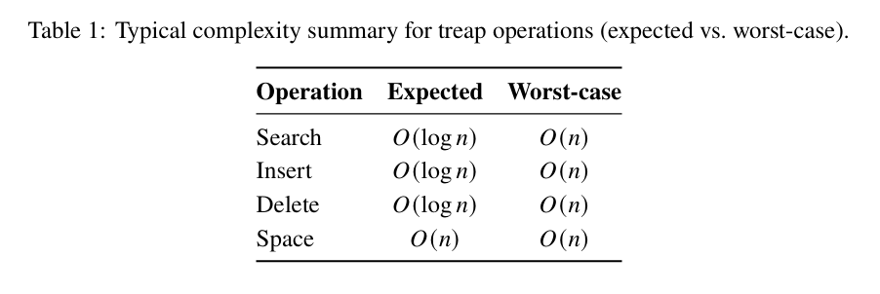
Time complexity

Slide 23
Applications

Slide 24
Ordered set / map (dictionary)
Supports: Insert, delete, search
Expected O(log n) time
Comparable to: AVL / Red-Black Trees
Key advantage:
Much simpler to implement
Practical benefit:
Less code → easier optimization

Slide 25
Order statistics and range queries (augmented treaps)
- Augment nodes with subtree size / aggregates
- Supports: k-th smallest element, rank of a key, count in range
- Can maintain sum / min / max over ranges
- Update info in O(1) per operation
- Useful for dynamic query problems

Slide 26
Dynamic sequence editor (implicit treap / rope)
- Implicit treaps use the in-order position as the key, representing a sequence instead of a set.
- With lazy propagation, range updates (e.g., reversing a segment) can be handled quickly.
🡪 dynamic sequence manipulation in algorithmic problems.

Slide 27
Flexible Structure for Custom Problems
Useful when:
Standard libraries are not enough
Can combine:
Ordering + custom queries + modifications
Key strength:
Write your own structure easily

Slide 28
Quizzes

Slide 29
Q1. In a treap, each node stores a pair (X, Y). Which statement is correct?
A. The tree satisfies the BST property by Y values and heap property by X. B. The tree satisfies the BST property by X values and heap property by Y. C. Both properties are based on X values. D. Both properties are based on Y values.

Slide 30
Q1. In a treap, each node stores a pair (X, Y). Which statement is correct?
A. The tree satisfies the BST property by Y values and heap property by X. B. The tree satisfies the BST property by X values and heap property by Y. C. Both properties are based on X values. D. Both properties are based on Y values.

Slide 31
Q2. What is the purpose of using a random priority Y value in a treap?
A. To reduce memory usage. B. To guarantee perfect balance. C. To avoid degeneration and achieve expected O(log⁡N) time complexity. D. To make search operations O(1).

Slide 32
Q2. What is the purpose of using a random priority Y value in a treap?
A. To reduce memory usage. B. To guarantee perfect balance. C. To avoid degeneration and achieve expected O(log⁡N) time complexity. D. To make search operations O(1).

Slide 33
Q3. What is the expected time complexity for each of Insert, Search, and Erase operation in a treap?
A. O(log⁡N). B. O(1). C. O(N). D. O(Nlog⁡N).

Slide 34
Q3. What is the expected time complexity for each of Insert, Search, and Erase operation in a treap?
A. O(log⁡N). B. O(1). C. O(N). D. O(Nlog⁡N).

Slide 35
Q4. What does the operation Split(T, X) do?
A. Splits the treap into two trees based on priority B. Splits the treap into two trees: left tree: keys ≤ X & right tree: keys > X C. Deletes all nodes with key > X D. Splits the tree based on height

Slide 36
Q4. What does the operation Split(T, X) do?
A. Splits the treap into two trees based on priority B. Splits the treap into two trees: left tree: keys ≤ X & right tree: keys > X C. Deletes all nodes with key > X D. Splits the tree based on height

Slide 37
Q5. What condition is required for the Merge(T1, T2) operation?
A. All priorities in T1 must be greater than those in T2 B. Both trees must have the same number of nodes C. All keys in T1 must be less than all keys in T2 D. Both trees must be balanced

Slide 38
Q5. What condition is required for the Merge(T1, T2) operation?
A. All priorities in T1 must be greater than those in T2 B. Both trees must have the same number of nodes C. All keys in T1 must be less than all keys in T2 D. Both trees must be balanced

Slide 39
Datasets

Slide 40
1. Synthetic data
Queries:
50% Find
40% Insert
10% Delete
Data:
Totally random data to compare with Arrays
Data with an increasing trend to compare with BST

Slide 41

1. Synthetic data
2. Google Web Traffic Time Series
Real-world daily traffic data for 144k Wikipedia articles recorded from 1/7/2015 to 31/12/2015
Problem: Continuously maintaining and querying the median value as new data points arrive in the stream.

Slide 42
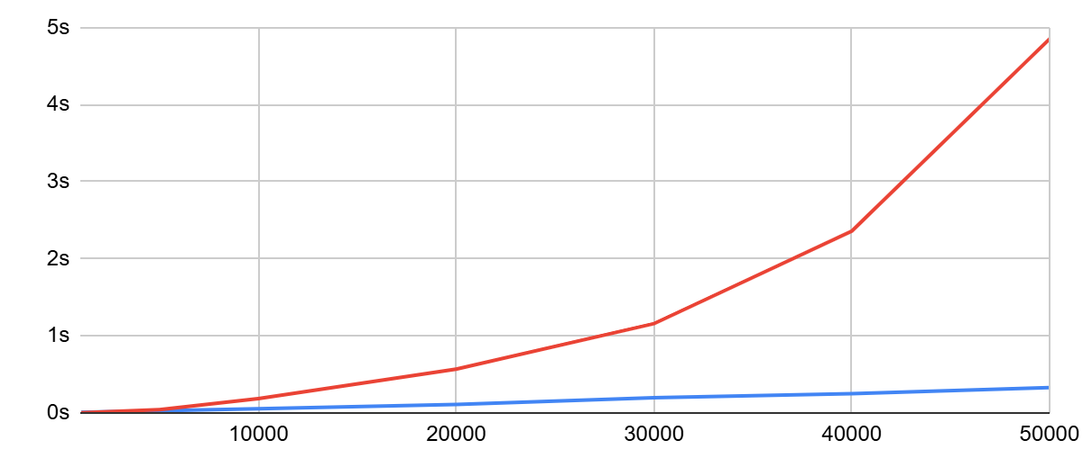
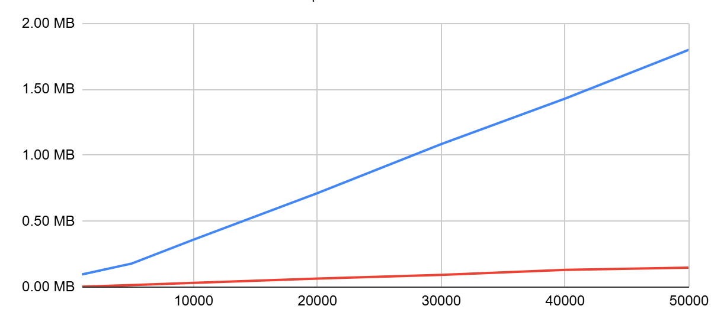

Comparisons between using Treap and array for find, insert, delete queries
Runtime
Memory Usage

Slide 43
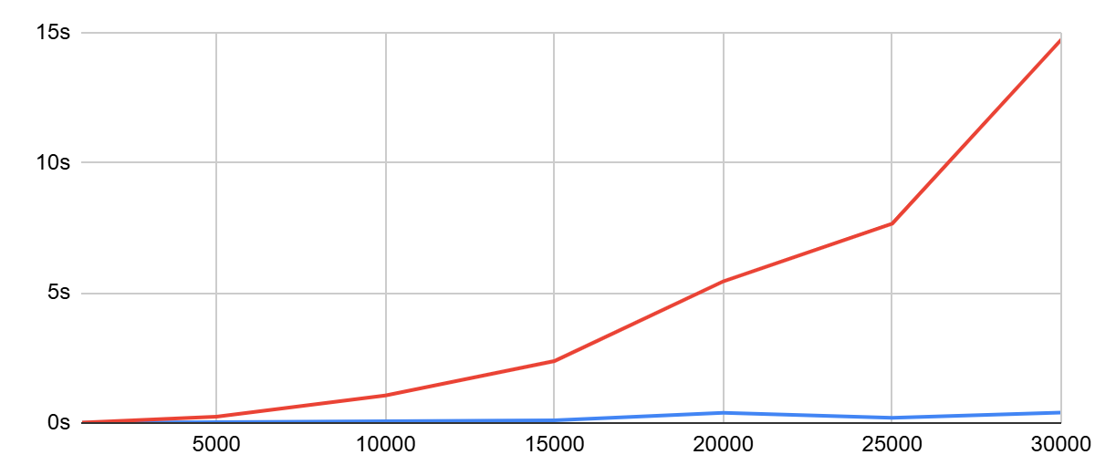
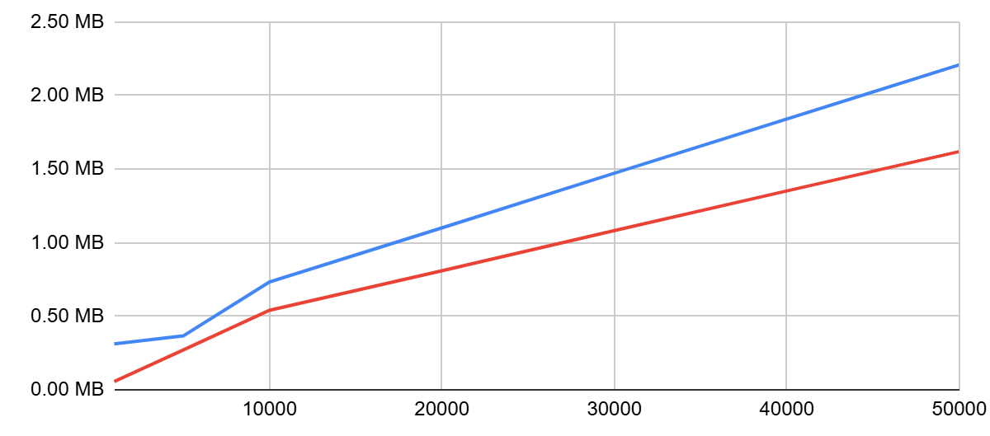

Comparisons between using Treap and BST in a dataset with an increasing trend
Runtime
Memory Usage

Slide 44
Assignment

Slide 45
Problem: ORDERSET - Order statistic set
You need to maintain a dynamic set of integers supporting the following operations:
I x → Insert x into the set (only if not already present)
D x → Delete x from the set (if present)
K k → Find the k-th smallest element
C x → Count how many elements are strictly smaller than x

Slide 46
💡 Hint:
For each node, store the size of its subtree (including itself)
Update size after every split/merge operation.
To find k-th element:
Compare k with size(left_child) to decide direction
To count the number of elements of S smaller than x:
Compare x with the key of the current node. When going to the right subtree, add size(left_child) + 1 to the answer

Slide 47
Tanks foe washing

